Slide 1

Home Credit Default Risk Prediction
Kaggle competition : https://www.kaggle.com/competitions/home-credit-default-risk
May 18, 2018 - Aug 30, 2018

Slide 2
Home Credit
Is an International consumer financial provider with operations in multiple European and Asian countries.
Default Risk
The risk a lender takes that a borrower will not make the required payments on a debt obligation such as a loan or a credit card.

Slide 3
Problem Overview
Many people struggle to get loans due to insufficient or non-existent credit histories. And, unfortunately, this population is often taken advantage of by untrustworthy lenders.
Home Credit has given some of the datasets by erasing personal details or the identities.
Our Task is to build a better machine learning model to help both Home Credit and borrowers by predicting default risk.

Slide 4
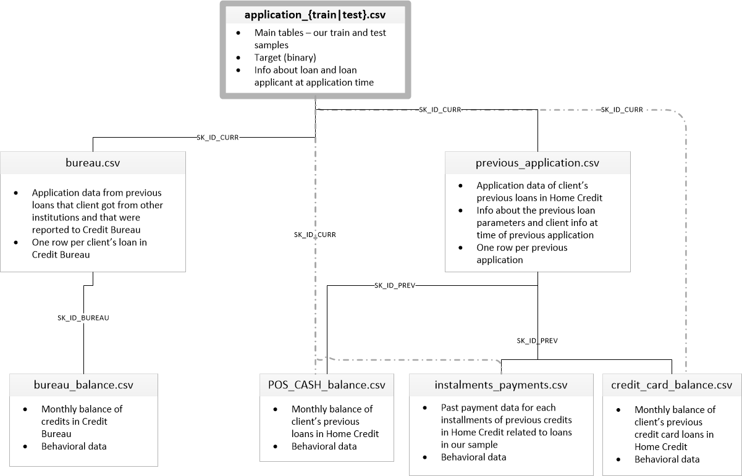

Slide 5
Solution
EDA on each Dataset
Feature Engineering and Combining Datasets
Check Class Imbalanceness
Determine Evaluation Metrics
Convert Categorical Features
Exploration on XGBoost model
Model Performance on Selected Features based on EDA
Performance after Selecting Features with Feature Importance
Handling the Outliers

Slide 6
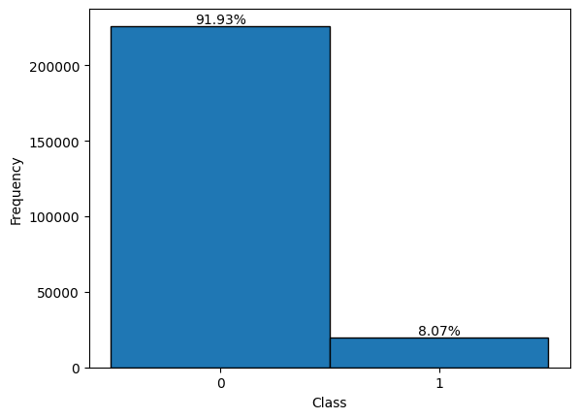
Check Class Imbalanceness

Slide 7
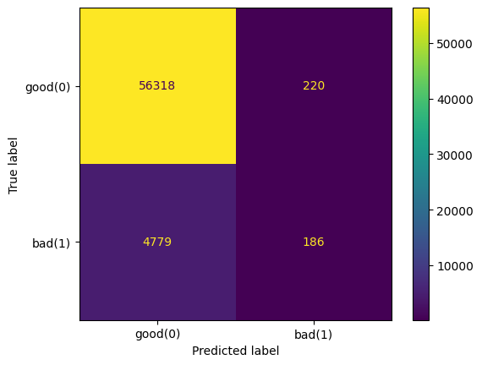

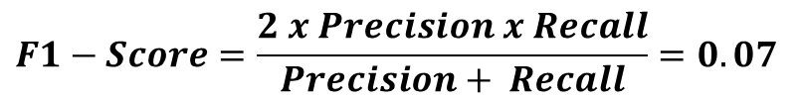
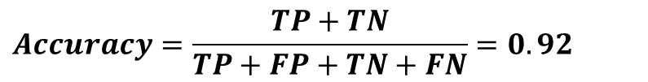
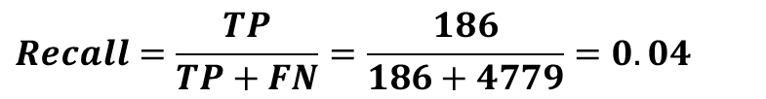
Determine Evaluation Metrics
Accuracy and Pricision is not enough for highly imbalanced
$Precision=\frac{TP}{TP+FP}=\frac{186}{186+220}=0.46$
$$Recall=\frac{TP}{TP+FN}=\frac{186}{186+4779}=0.04$$
$$Accuracy=\frac{TP+TN}{TP+FP+TN+FN}=0.92$$
$$F1−Score=\frac{2 x Precision x Recall}{Precision+ Recall}=0.07$$

Slide 8
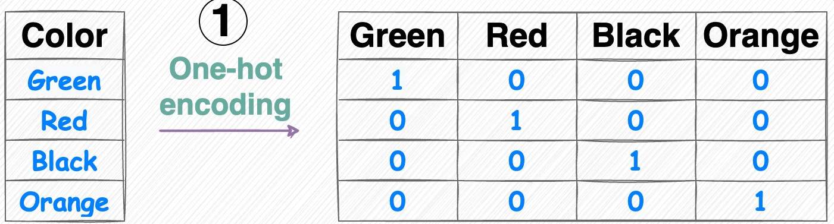
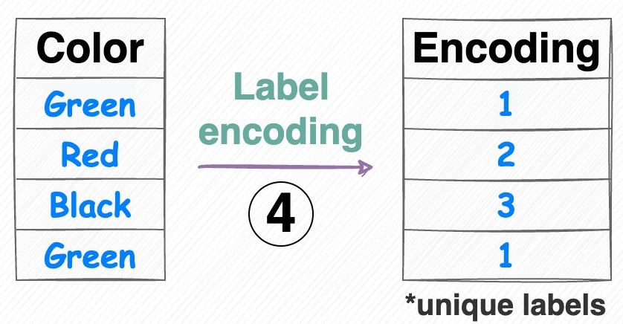
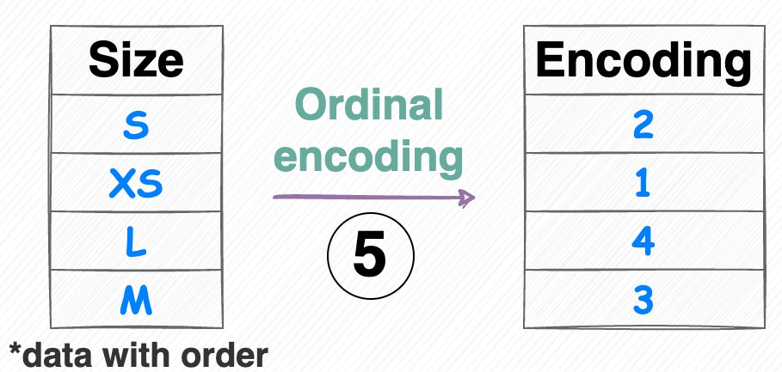
Convert Categorical Features
One Hot Encoding
Label Encoding
Ordinal Encoding

Slide 9
How XGBoost Works ?
Initialization
Calculate Residuals
Fit a Decision Tree
Calculate Similarity Score and Gain
Pruning
Calculate Leaf Weights/Outputs
Update Predictions
Repeat for Multiple Trees
Final Model
https://drive.google.com/file/d/1Of2qEVidq0EjRgV-iBboI_vFyV3p7cHs/view?usp=drive_link

Slide 10
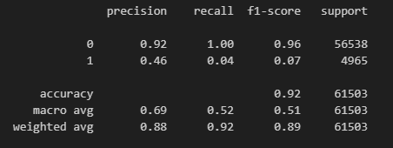
Model Performance on Selected Features based on EDA
Classification Report
Confusion Matrix

Slide 11
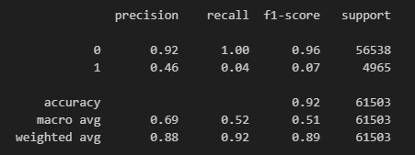
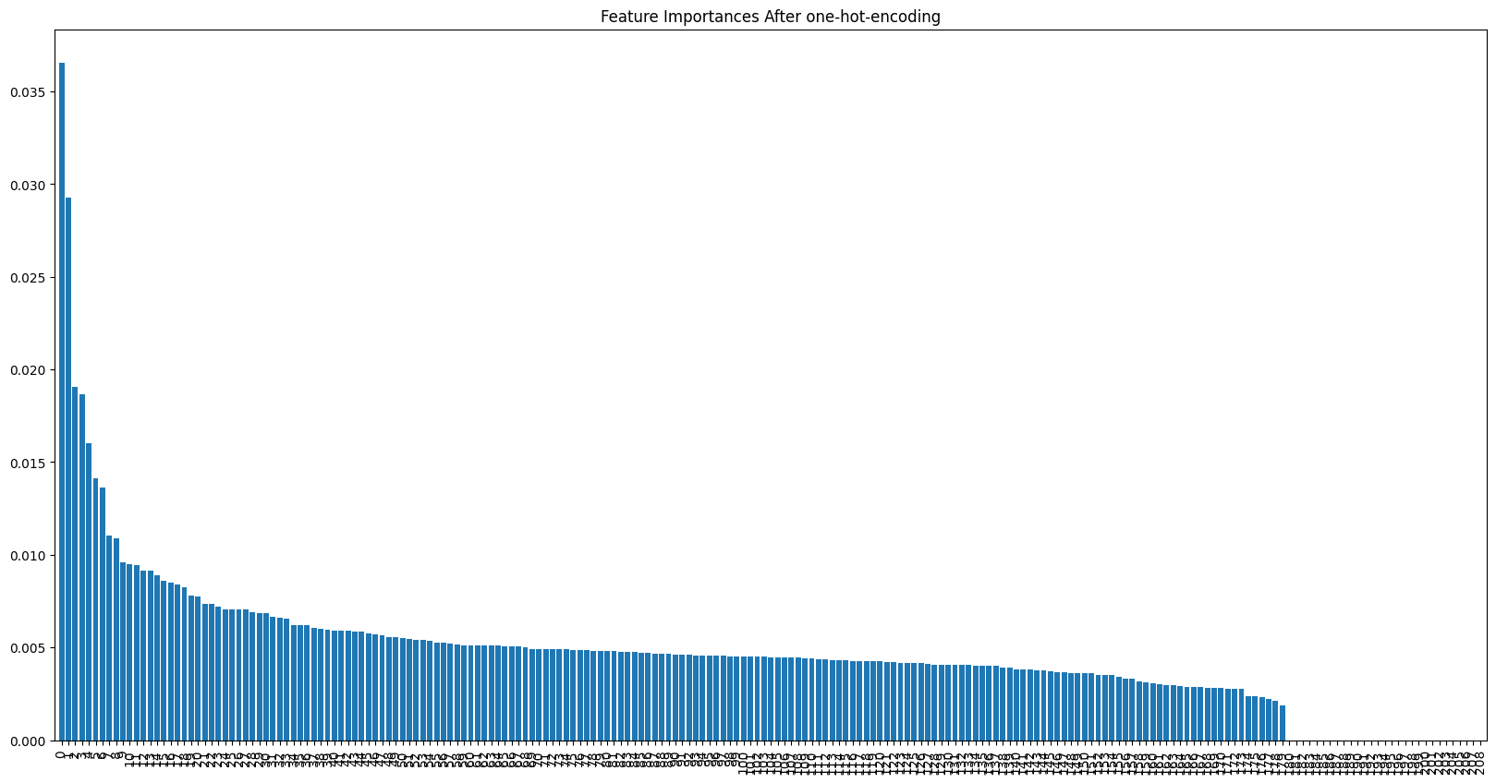
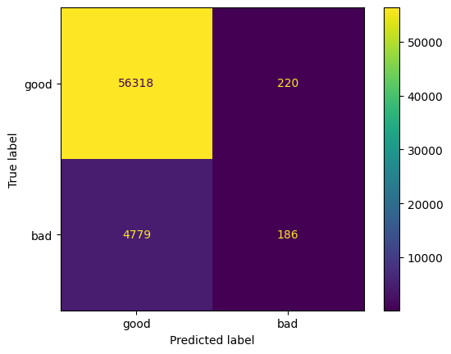
Performance after Selecting Features based on Feature Importance
Feature Importances in Decending Order

Slide 12
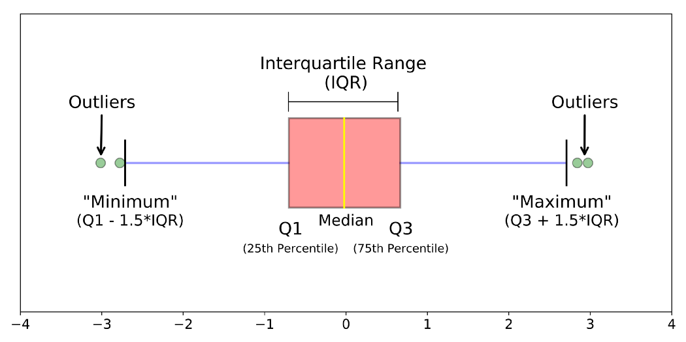
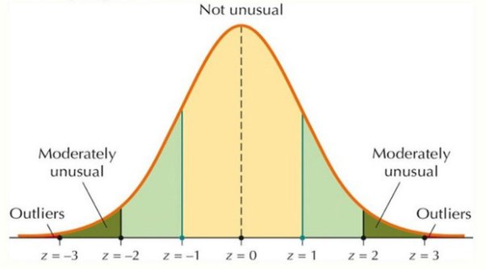
Handling the Outliers
IQR Method
Z-Score Method

